Slide 1
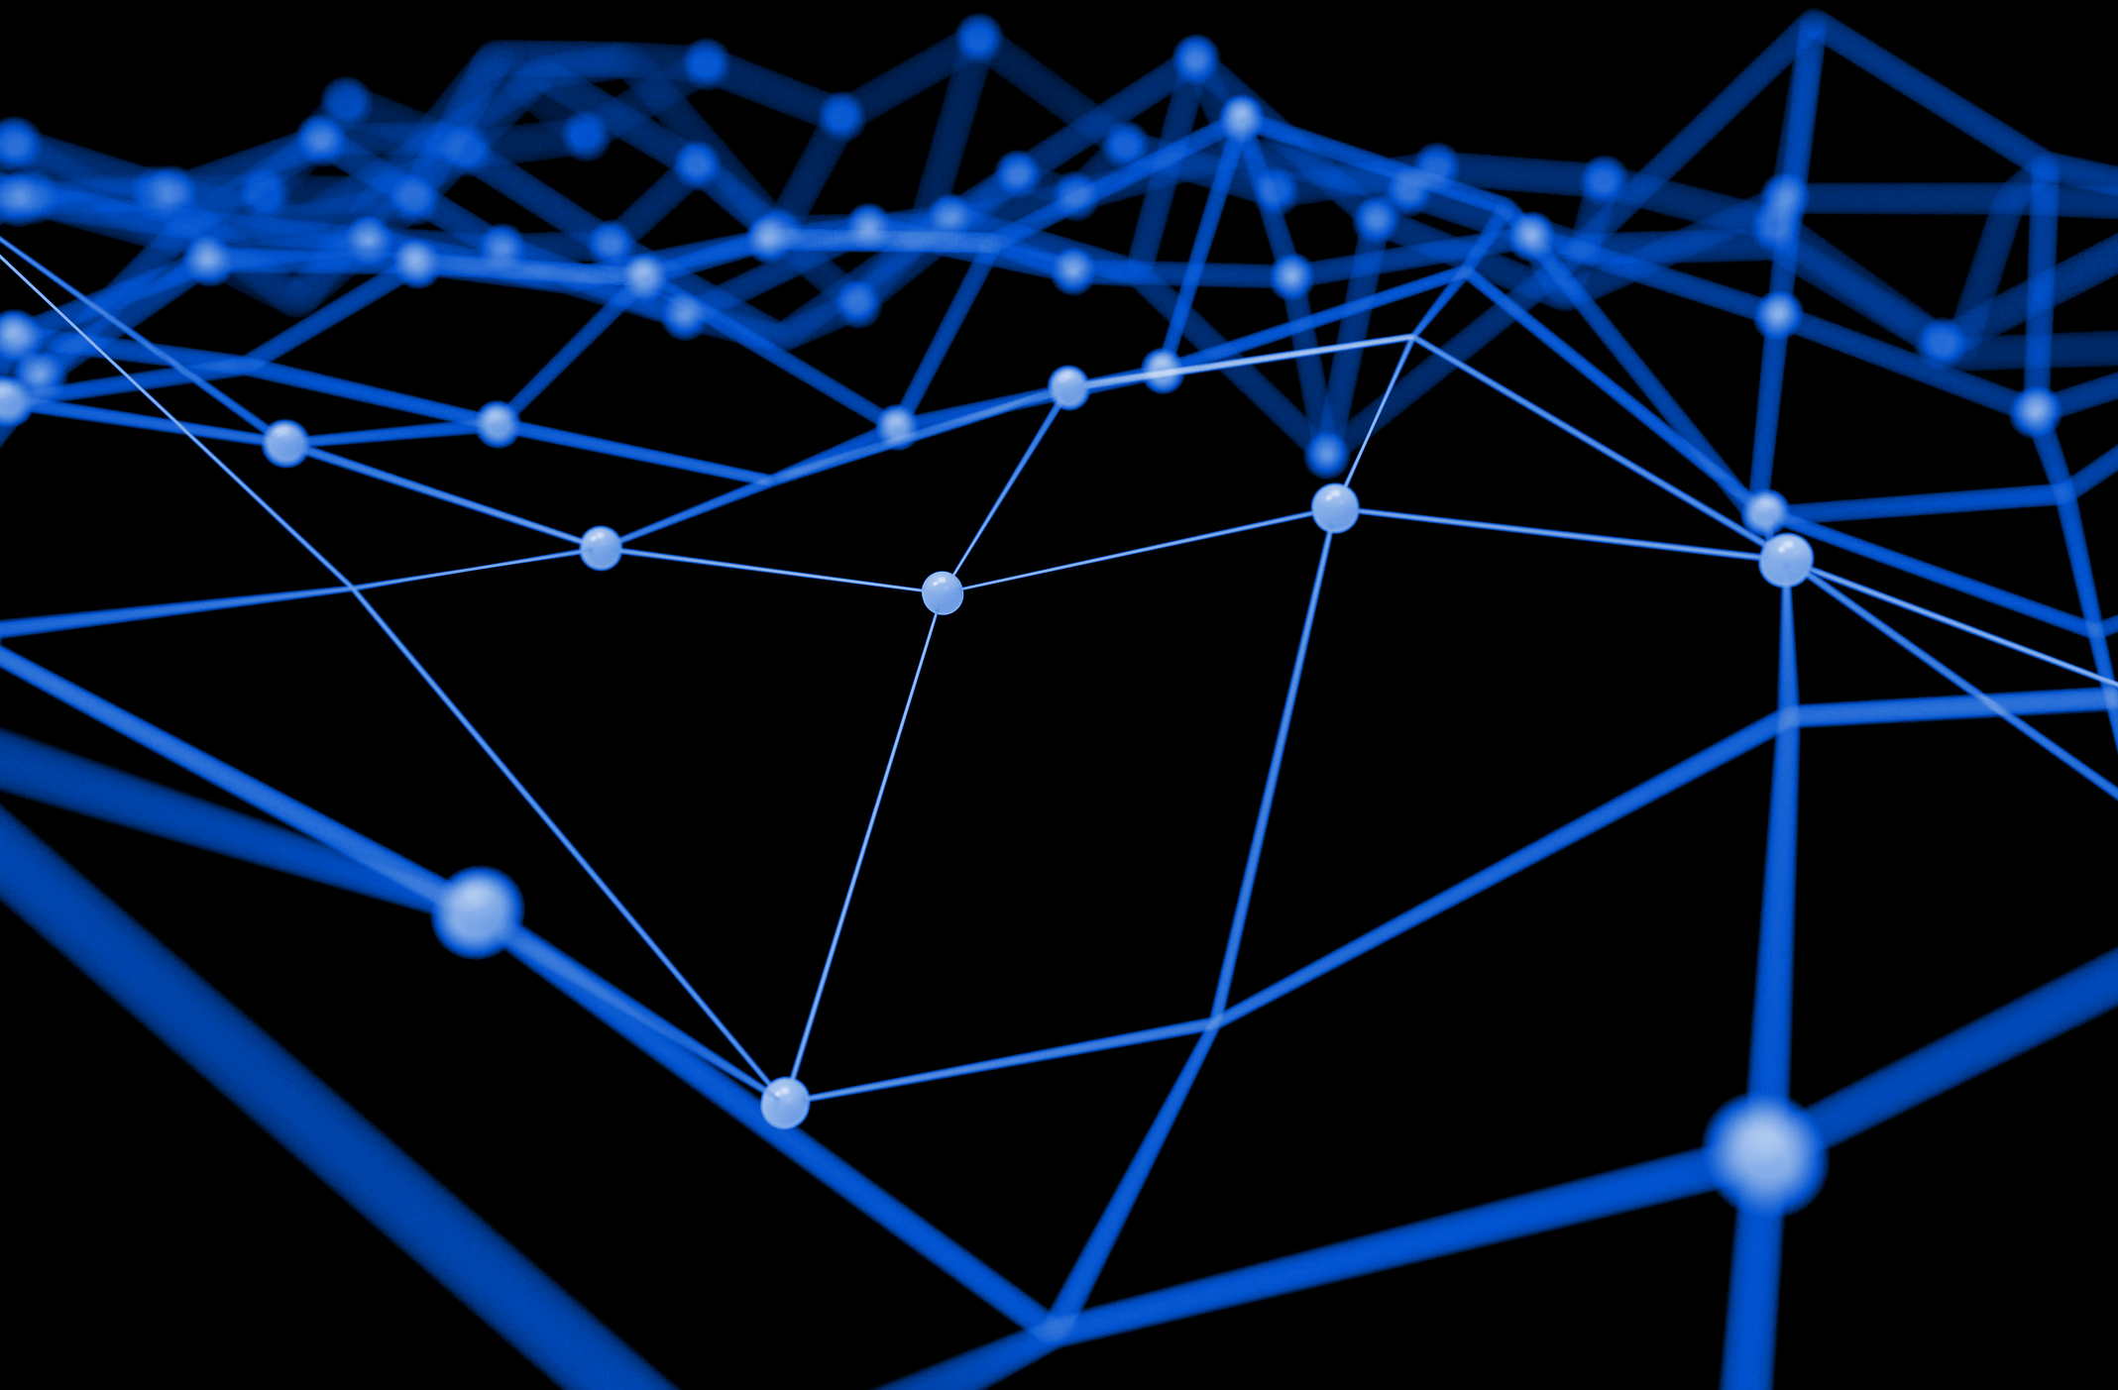
Blockchain

Slide 2
Table of Contents
4 – What is a blockchain?
6 – Data Provenance
7 – Decentralization
8 – Permissioned Ledgers
10 – Smart Contracts
11 – Real Estate Use Case

Slide 3
“The job isn't to catch up to the status quo; the job is to invent the status quo. ”
-Seth Goden

Slide 4
What is a blockchain and why should I care?
It is a ledger that uses cryptography to secure transactions or timestamped data and link blocks of data together. Think of a blockchain as a modular designation.
Think of it like a logging system that is replicated and distributed amongst all the users in a network, at the moment, consensus is achieved by BitCoin and Ethereum blockchains through verifying transactions by racing to calculate hashes by miners, a process called proof-of-work.
Great for a mystical sounding thing called “data provenance” by that, when/where did the data begin and who owns it? It is transparent, if I wanted to record intellectual property rights I may want to put it in a blockchain to be sure that I was the first one to think of it.

Slide 5
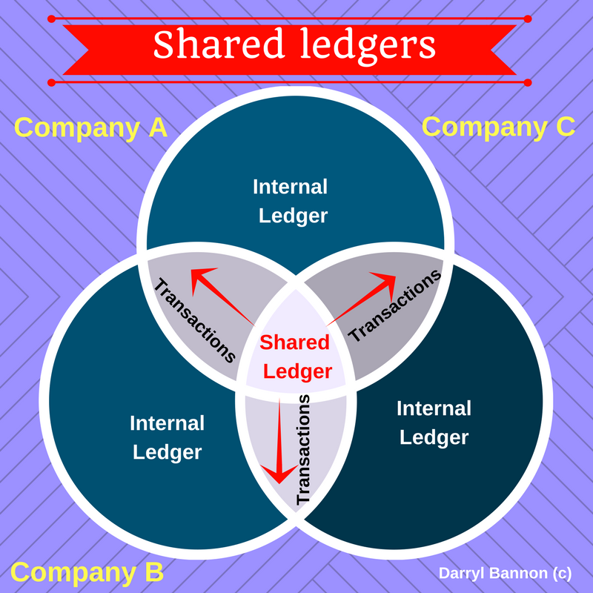
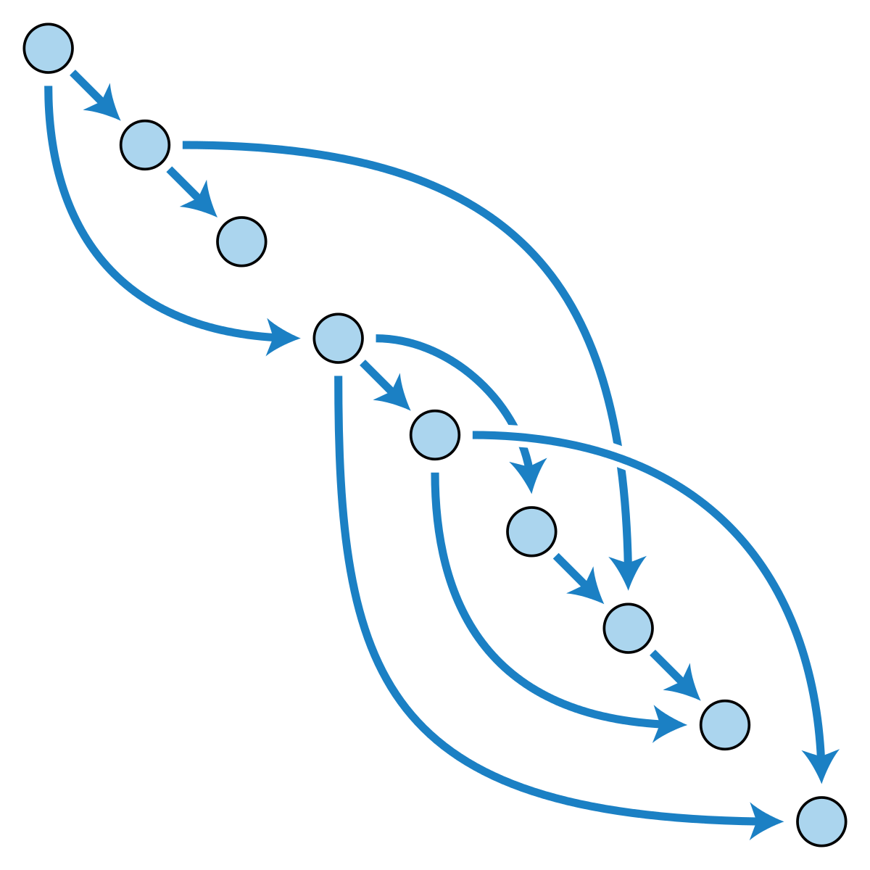
Data provenance
When/where did the data begin and who owns it?
Triple-entry accounting. Time-stamped data that is appended and validated.
One directional graph or directed acyclic graph

Slide 6
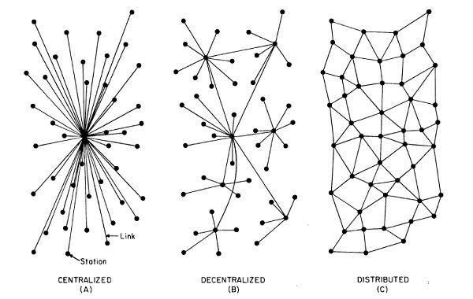
Degrees of Centralization:
Centralized – one entity has all control and holds all info
Decentralized – several points have control and info
Distributed – every point has the info (and maybe has control, depending on the implementation)

Slide 7
Permissioned Ledgers
Selected individuals can transact and validate transactions on the network.
Pros:
Greater number of transactions per second.
Cons:
Not as much of a purists view of blockchain (permissioned governance)
Lacks the security of more trustless systems.
Central point of failure.

Slide 8

Permissionless Ledgers
Public blockchain: most recognizable is BitCoin and Ethereum.
Pros:
Anyone can contribute data to the ledger and no actor can prevent a transaction from being appended. Censorship resilient. All participants have access to identical copies of the blockchain.
Anonymous/Pseudonymous transactions (pseudonymous indicates that your identity is not completely anonymous).

Slide 9
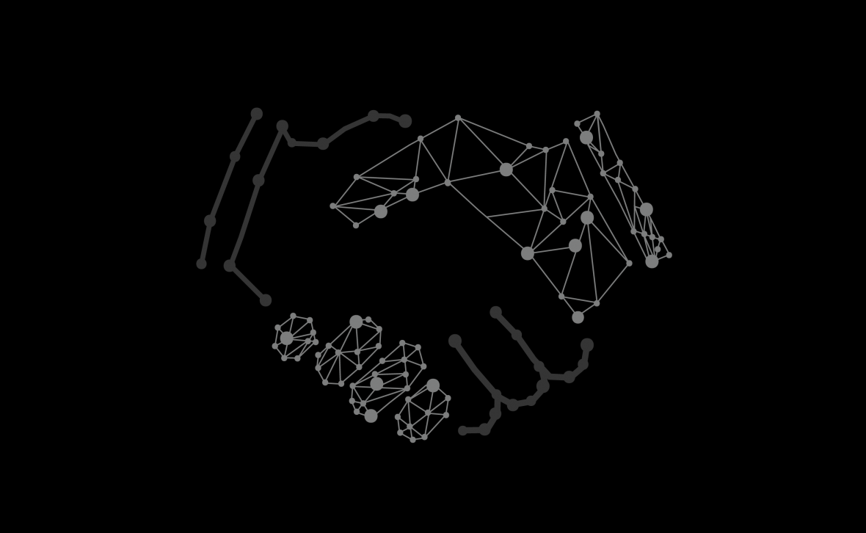
What is a smart contract?
Software that executes transactions on a blockchain.
With expanded standardization can automate events in the lifecycle of a contract.
Applications in real-estate: property title transfer and recording, escrow agreements, listing, insurance, etc.

Slide 10
Real Estate Blockchain Pilot Program in US
In 2016, Cook County, Illinois began tracking and transferring property titles with paper deed and digital token.
Cook County Recorder of Deeds current enterprise land records software vendor, Conduent (formerly Xerox/ACS) has agreed to incorporate some of the technology used in blockchains, particularly file hashing and data integrity certification, into the new land records system currently being installed at CCRD. Both parties will work together over the next year to explore further possible uses.

Slide 11
Summary
Blockchain is a ledger that uses cryptography to secure transactions or timestamped data and link blocks of data together
There is both permission less and permissioned ledgers
Smart contracts are software programs on the blockchain

